Slide 1

Music Recommendation System
Team 4:
Anand Surya
Harshal Bendale
Muriel Banze
Saumya Nagia

Slide 2
Agenda
Topic Introduction
What makes a recommendation system good?
Music Recommendation is not just shopping
Problem Statement
Key Issues
Alternatives approaches and Limitations
Methodology
Conclusions
Future work
References

Slide 3
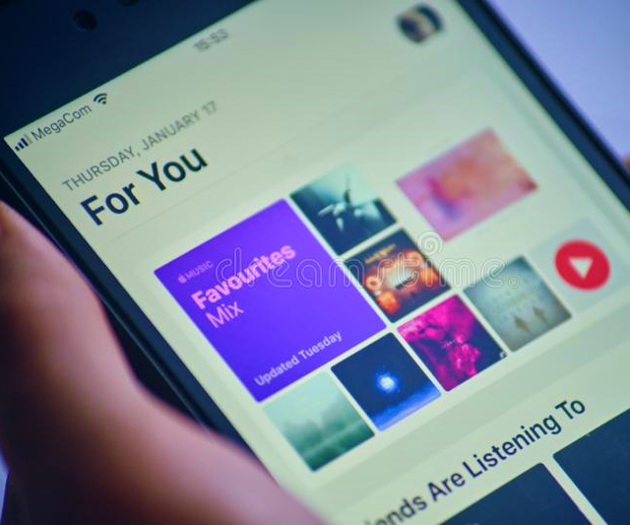
Introduction
With the development of Internet in recent years, we can access music from large music databases.
However, due to rapid growth of digital music data raised issues for user to select songs based on their preferences. Therefore, a demand for a music recommendation system comes into picture.
A music recommendation system receives a user selection of desired music, retrieves analysis data associated with the selected music, and generates a playlist of songs based on the analysis data.

Slide 4
Introduction (Continued)
What makes a recommendation system good?
Relevance
Serendipity/Novelty
Transparency/Trust
Context
Reach
Music Recommendation is not just shopping but,
Discovery
Exploration
Play
Organization
Play listing
Doesn’t have to look like a spreadsheet

Slide 5
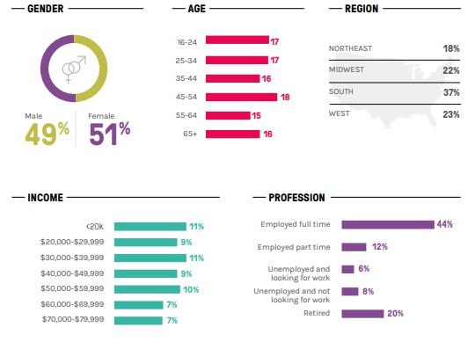
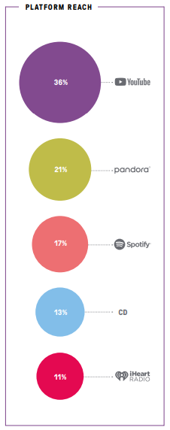
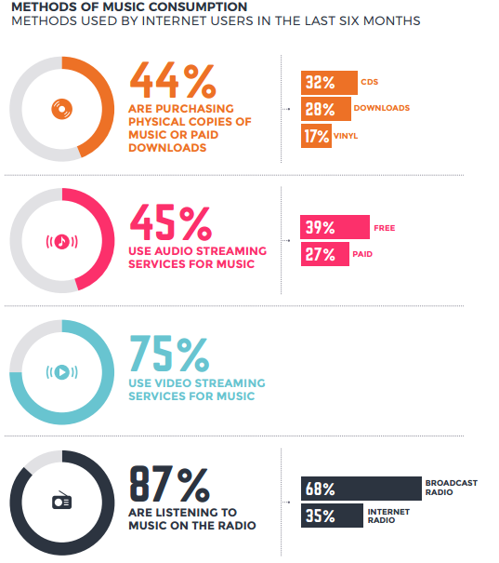
Music Consumption
Fig 2: Average user statistics listening to music
Fig 3: Platform reach
Fig 4: Methods of Music consumption

Slide 6
Problem Statement
Ideally, a music recommendation system should display songs depending on the users preferences and generate a playlist. All the songs in the playlist generated must exactly match the users criteria. The user need not browse through the internet for more recommendations and have all the songs at their disposal provided by the music recommendation system.
In reality, not every song generated by the system’s playlist would meet the users mood/preference, resulting in the user looking out for more songs.
An approach made by using Text analysis can solve the issue. A recommendation system implemented using such a technique can provide relevant recommendations of music for the user. Thereby making it more customized and end user oriented.

Slide 7
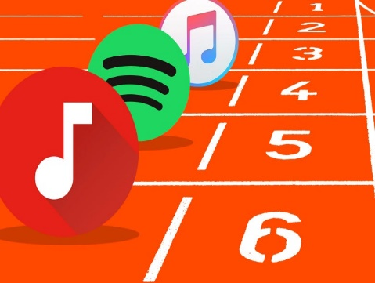
Key Issues, Approaches and Limitations
1. Spotify -- Large Scale, Low Latency, P2P Music-on-Demand Streaming by G. Kreitz and F. Niemela
Spotify is a streaming music service that uses peer-to-peer techniques. This service has a library of over 8 million tracks, allowing users to freely choose tracks they wish to listen to and to seek within tracks. To reduce server costs it is done using TCP as a transport protocol.
Limitation: Song skips are hardly considered. There is little difference of recommendations depending on the time of the day and day of the week.
2. Pandora Music by Will Glaser, Jon Kraft and Tim Westergren
The basic idea was to have musicians listen to and decode a song's “DNA” and then categorize it according to different musical qualities such as meter and tonality. Numbers are assigned to the over 450 different attributes, and Pandora's algorithm went to work, finding other songs that match these same qualities
Limitation: There is almost no conversation with the listener, to get confirmation of implicit choices or key computed dimensions of listeners profile.

Slide 8
Key Issues, Approaches and Limitations (Continued)
3. Apple Music by Trent Reznor
This system has access to a "deep historical knowledge" of user tastes and habits by aggregating years of iTunes listening data. For example, high star ratings and frequent plays over the years will push tracks and albums to the My Favorites Mix.
Limitation: The speed of personalization is rather slow, not capitalizing on behavioral data collected.
4. YouTube Music by Jay Fowler and Lyor Cohen
YouTube Music is a streaming platform that gives you easy access to official song audio and videos in one single place.
Limitation: There are bad recommendations because of poor quality metadata.

Slide 9

Methodology
Core Algorithm:
TF-IDF (Term Frequency–Inverse Document Frequency):
In information retrieval, TF–IDF or TFIDF is a numerical statistic that is intended to reflect how important a word is to a document in a collection or corpus. It is often used as a weighting factor in searches of information retrieval, text mining, and user modeling.
Cosine Similarity:
It is a measure of similarity between two non-zero vectors of an inner product space that measures the cosine of the angle between them.

Slide 10
Methodology (Continued)
(Core algorithm) Implementation stages:
Use read_csv to read the CSV data into Python program.
Pre-processing:
Convert to lowercase
Removal of punctuation (Deals with comma removal separately due to complications from CSV nature)
Apostrophe removal
Stop words removal
Stemming the resultant set of words
Tokenization into words
Document Frequency calculation:
Maintain a Python dictionary to maintain word occurrences in different documents. <Word, Documents_frequency> (Key, Value)
Calculation of TF-IDF:
Calculate the TD-IDF against the word count while also maintaining the check for smoothing. (We smooth with addition of a ‘constant’ “1” if needed).
Calculation of Cosine Similarity:
We make use of Dot product of vectors using numPy lib for every vector query and find ratio against product of vector norm.

Slide 11
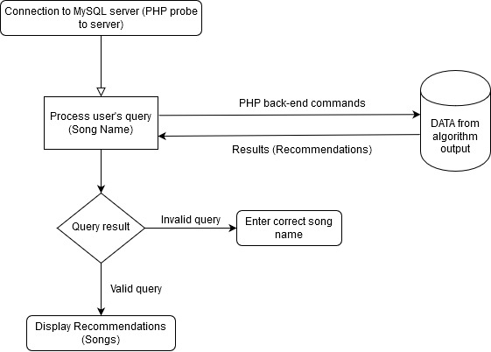
Methodology (Continued)
Backend:
Database Client Version: libmysql - MySQL 5.0.12 and PHP 7.2
Tools used: PHPMyAdmin GUI
Web Server: Apache
The CSV raw processed data is hosted is loaded into the MySQL database hosted in the web server:
https://knowledgeptprojectdemo.000webhostapp.com/
The PHP script codes communicate with the MySQL database, fetches the data and parses it to the front-end (Both WebApp and Mobile App).
Fig 5: Back-end flow

Slide 12
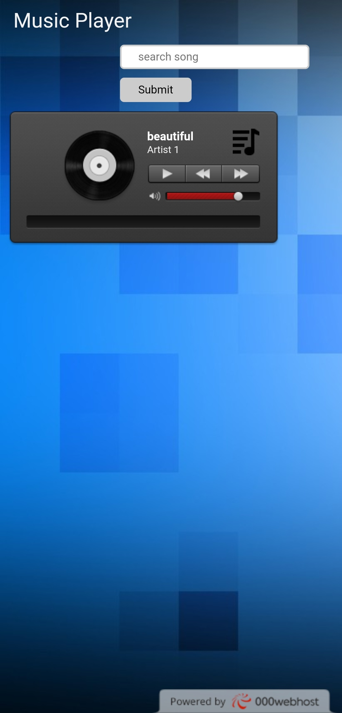
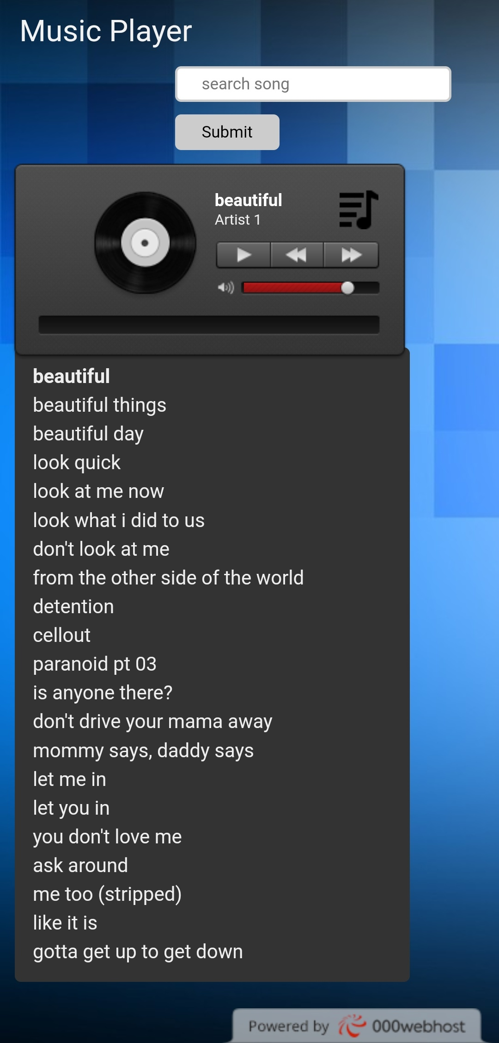
User Interface
Functionality keys:
Play button to play the current song
Forward button to seek to next song in the playlist (Recommended songs’ playlist).
Backward button to seek to previous song in the playlist.
🎶 Playlist button (Music symbol) to view the recommendations.
Fig 6: Mobile App User interface display
Fig 7: Mobile Application displaying the list of songs recommended

Slide 13
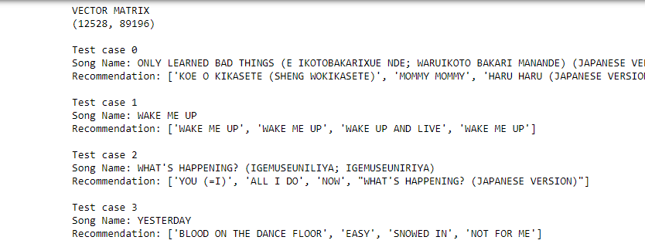
Validation
The original dataset consists of A-Z csv files. Consider the B csv file which has 12000+ records as input. For display purpose we generate up to 100 records as recommendations. The output consists of a vector matrix generated and a list of first 100 recommendations
For each test case, four similar songs are displayed pertaining to that song.
Fig 8: Screenshot displaying test cases of the output generated

Slide 14
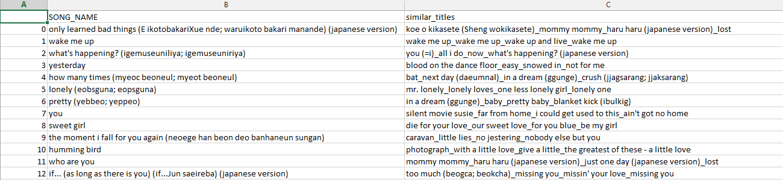
Validation (Continued)
The result is stored onto the Export_B_Recommendation.csv
This file contains the name of the song and its related recommendations
Fig 9: Screenshot displaying song records in the exported file

Slide 15
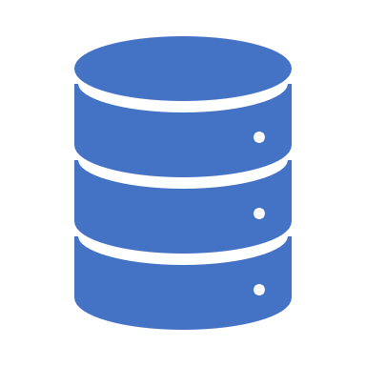
Conclusion
A music recommendation system was developed that is capable of generating a playlist based on the user's preferences by using Text analysis.
The system utilizes data from an unstructured dataset and uses it to display recommended songs to the user.
The recommendations in the playlist are ranked based on TF-IDF and Cosine Similarity (Higher to lower rank).
A web and mobile application is created which is capable of generating a playlist and displaying a record of 20 songs based on the user's preferences.

Slide 16

Future Work
The future recommended system could be designed in such a way that is capable of not only recommending songs but also display lyrics simultaneously to the user as well.
Further enhancements can be made regarding the user interface to make it more user friendly.
Promoted or sponsored content can be customized based on the user's music preference by using Text analysis. For example suggest health related advertisements when a user is listening to music related to workout instead of showing insurance advertisements unnecessarily.
Emotional branding when incorporated with music can result in the user take up activities which could be beneficial in terms of health and lifestyle to the user.

Slide 17

References
[1] “Americans Listen to 151 Minutes of Music Each Day,” Digital Music News, Sep. 18, 2018. https://www.digitalmusicnews.com/2018/09/17/latest-music-biz-audiencenet-music-listening-time/ (accessed Apr. 07, 2020).
[2] “Music listening in 2019: 10 takeaways from the IFPI’s new report.” https://musically.com/2019/09/24/music-listening-2019-ifpi-report/ (accessed Apr. 07, 2020).
[3] G. Kreitz and F. Niemela, "Spotify -- Large Scale, Low Latency, P2P Music-on-Demand Streaming," 2010 IEEE Tenth International Conference on Peer-to-Peer Computing (P2P), Delft, 2010, pp. 1-10.
[4] S. Shukla, P. Khanna and K. K. Agrawal, "Review on sentiment analysis on music," 2017 International Conference on Infocom Technologies and Unmanned Systems (Trends and Future Directions) (ICTUS), Dubai, 2017, pp. 777-780.

Slide 18
Thank You!

